Slide 1
Alex A. Khorram
Confidential and Proprietary

Slide 2
iQ for machines
machineQ is a new Comcast business focused on leveraging the latest in sensor, network, and software technologies to gather, transmit, and create actionable intelligence from the physical world.

Slide 3











The promise of The Internet of Things
Virtually every facet of life is expected to be positively impacted
Hospitals
AIRPORTS
VENUE/FACILITY MANAGEMENT
MALLS
UNIVERSITIES
SUPERMARKETS/RESTAURANTS
SMART CITIES/ INFRASTRUCTURE
SMART AGRICULTURE
CONNECTED LABORATORIES
AMUSEMENT PARKS
Confidential and Proprietary Comcast Information
Notes:
Needs gray background boxes

Slide 4
However, BILLIONS OF DEVICES SHOULD BE CONNECTED BUT AREN’T
Most existing solutions:
Lack adequate coverage
Require too much power
Are cost prohibitive

Slide 5




non-technical hurdles have also slowed adoption
The majority of end users lack viable options for their connectivity needs
Consumer Focused
“Bring Your Own Connectivity”
Private IoT Network
Start-Up, Public IoT WANs
Low ROI
Novelty vs. Necessity
Un-pairing/Onboarding challenges
Persistent Maintenance
Expensive
No Economies of Scale
Narrow selection of use cases
Lack of standardization
Stability and reliability concerns for Enterprise partners

Slide 6
Lpwan is a disruptive tech that will finally enable new types of devices to connect
LOCAL AREA
NETWORK
Short range
communication
CELLULAR NETWORK
Traditional M2M
1,000 kbps
2G, 3G, LTE (Wireless Carriers)
100 kbps
Speed
Wi-Fi (MVPDs)
Zigbee
Bluetooth
BLE (MVPDs)
LOW POWER WIDE AREA
(LPWAN) Internet of things
1 kbps
10 bps
Range
10 m
100 m
1 km
10 km
*Ericsson, Machina: Figures and projections for connected devices are US only
Notes:
LOCAL AREA NETWORK
Short range communication
40%
Well established standards
In building
Battery lifetime
Provisioning
Network cost & dependencies
LOW POWER WIDE AREA
(LPWAN) Internet of things
45%
Low power consumption
Low cost
Positioning
High data rate
Emerging standards
CELLULAR NETWORK
Traditional M2M
15%
Existing coverage
High data rate
Battery lifetime
Total cost of ownership

Slide 7










LPWAN TECHNOLOGY IS READY FOR PRIME TIME
LPWAN networks
are already deployed
in major Western
European and
Asian markets
Global standards have
been established by
the LoRa® Alliance (now over 400+ members)
Major hardware
providers (e.g. Cisco)
and integrators (e.g.
IBM) are adopting
the technology
LPWAN chip sets &
enabled devices for
many use cases are available off the shelf

Slide 8





Machineq product offerings
Sensors
LoRa Gateway
Network Server
Applications
Connectivity as a Service
CUSTOMER
COMCAST
COMCAST
CUSTOMER
Sensors
LoRa Gateway
Network Server
Applications
Managed IoT
COMCAST
COMCAST
COMCAST
COMCAST or CUSTOMER

Slide 9




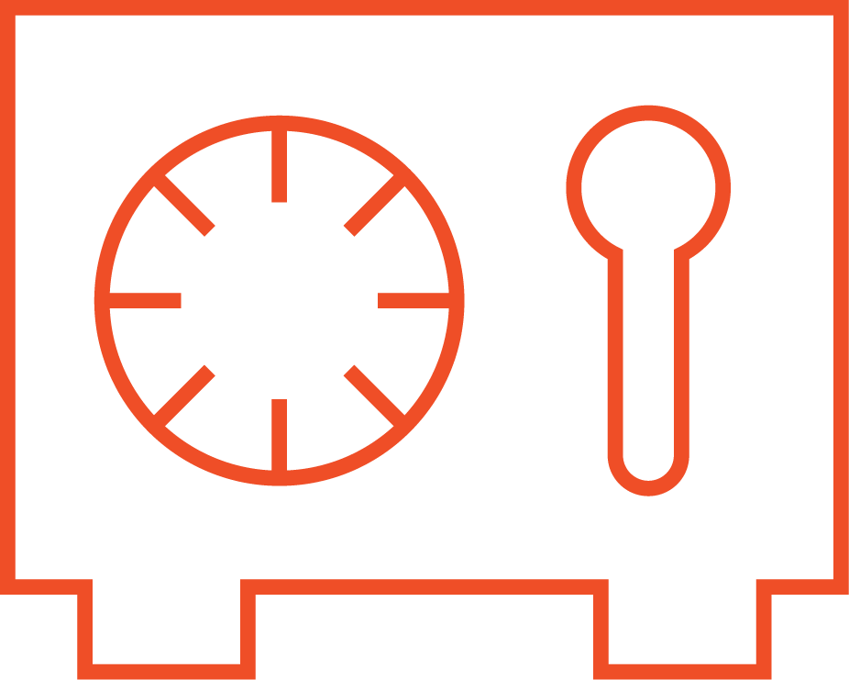


detailed iot product stack
10
Digital Service
7
Information & IoT Software
6
Analytics Tools and Data Visualization
Data Services
5
Customer Solution
8
9
Device Agnostic IoT Platform and Data Aggregator
Systems Integration
Consultancy
Data Storage / Hosting
Security
4
Connectivity
3
Future Protocols
Sensor / Actuator
2
Physical Thing
1
Ecosystem of Connected Devices

Slide 10









Initial FOCUS VERTICALS
Smart Buildings
Temperature Monitoring
Leak Detection
Smart Parking
Asset Tracking
Remote Locking
Smart Lighting
Utilities
Smart Metering
Usage Detection
Transportation
Fleet management/tracking
Cold chain monitoring/logistics
Smart Waste
Fill-level Monitoring
Route Optimization
Parks/Resorts
Asset Tracking
Smart Lighting
Vibration Monitoring
Smart Parking
Guest Experience
Energy Consumption
Smart Cities
Smart Lighting
Energy Consumption
Smart Parking
Universities
Asset Tracking
Temperature/humidity monitoring
Restaurants
Temperature Monitoring
Fill-level Monitoring
Laboratories
Temperature/humidity monitoring
Fill-level Monitoring
Airports
Customer experience/satisfaction
Asset Tracking
Smart Lighting/Energy Consumption

Slide 11
PILOT MARKETS
Comcast Footprint
55 MILLION
Homes and Businesses Passed
California Region:
Deployments beginning imminently;
50% coverage through Q1/Q2
Freedom Region:
Center City deployed;
50% coverage in Q1
19/25
Top DMAs
28MILLION
customer relationships
Ability to launch ‘campus’ deployments for certain stakeholders even before machineQ reaches full footprint deployment with WAN

Slide 12
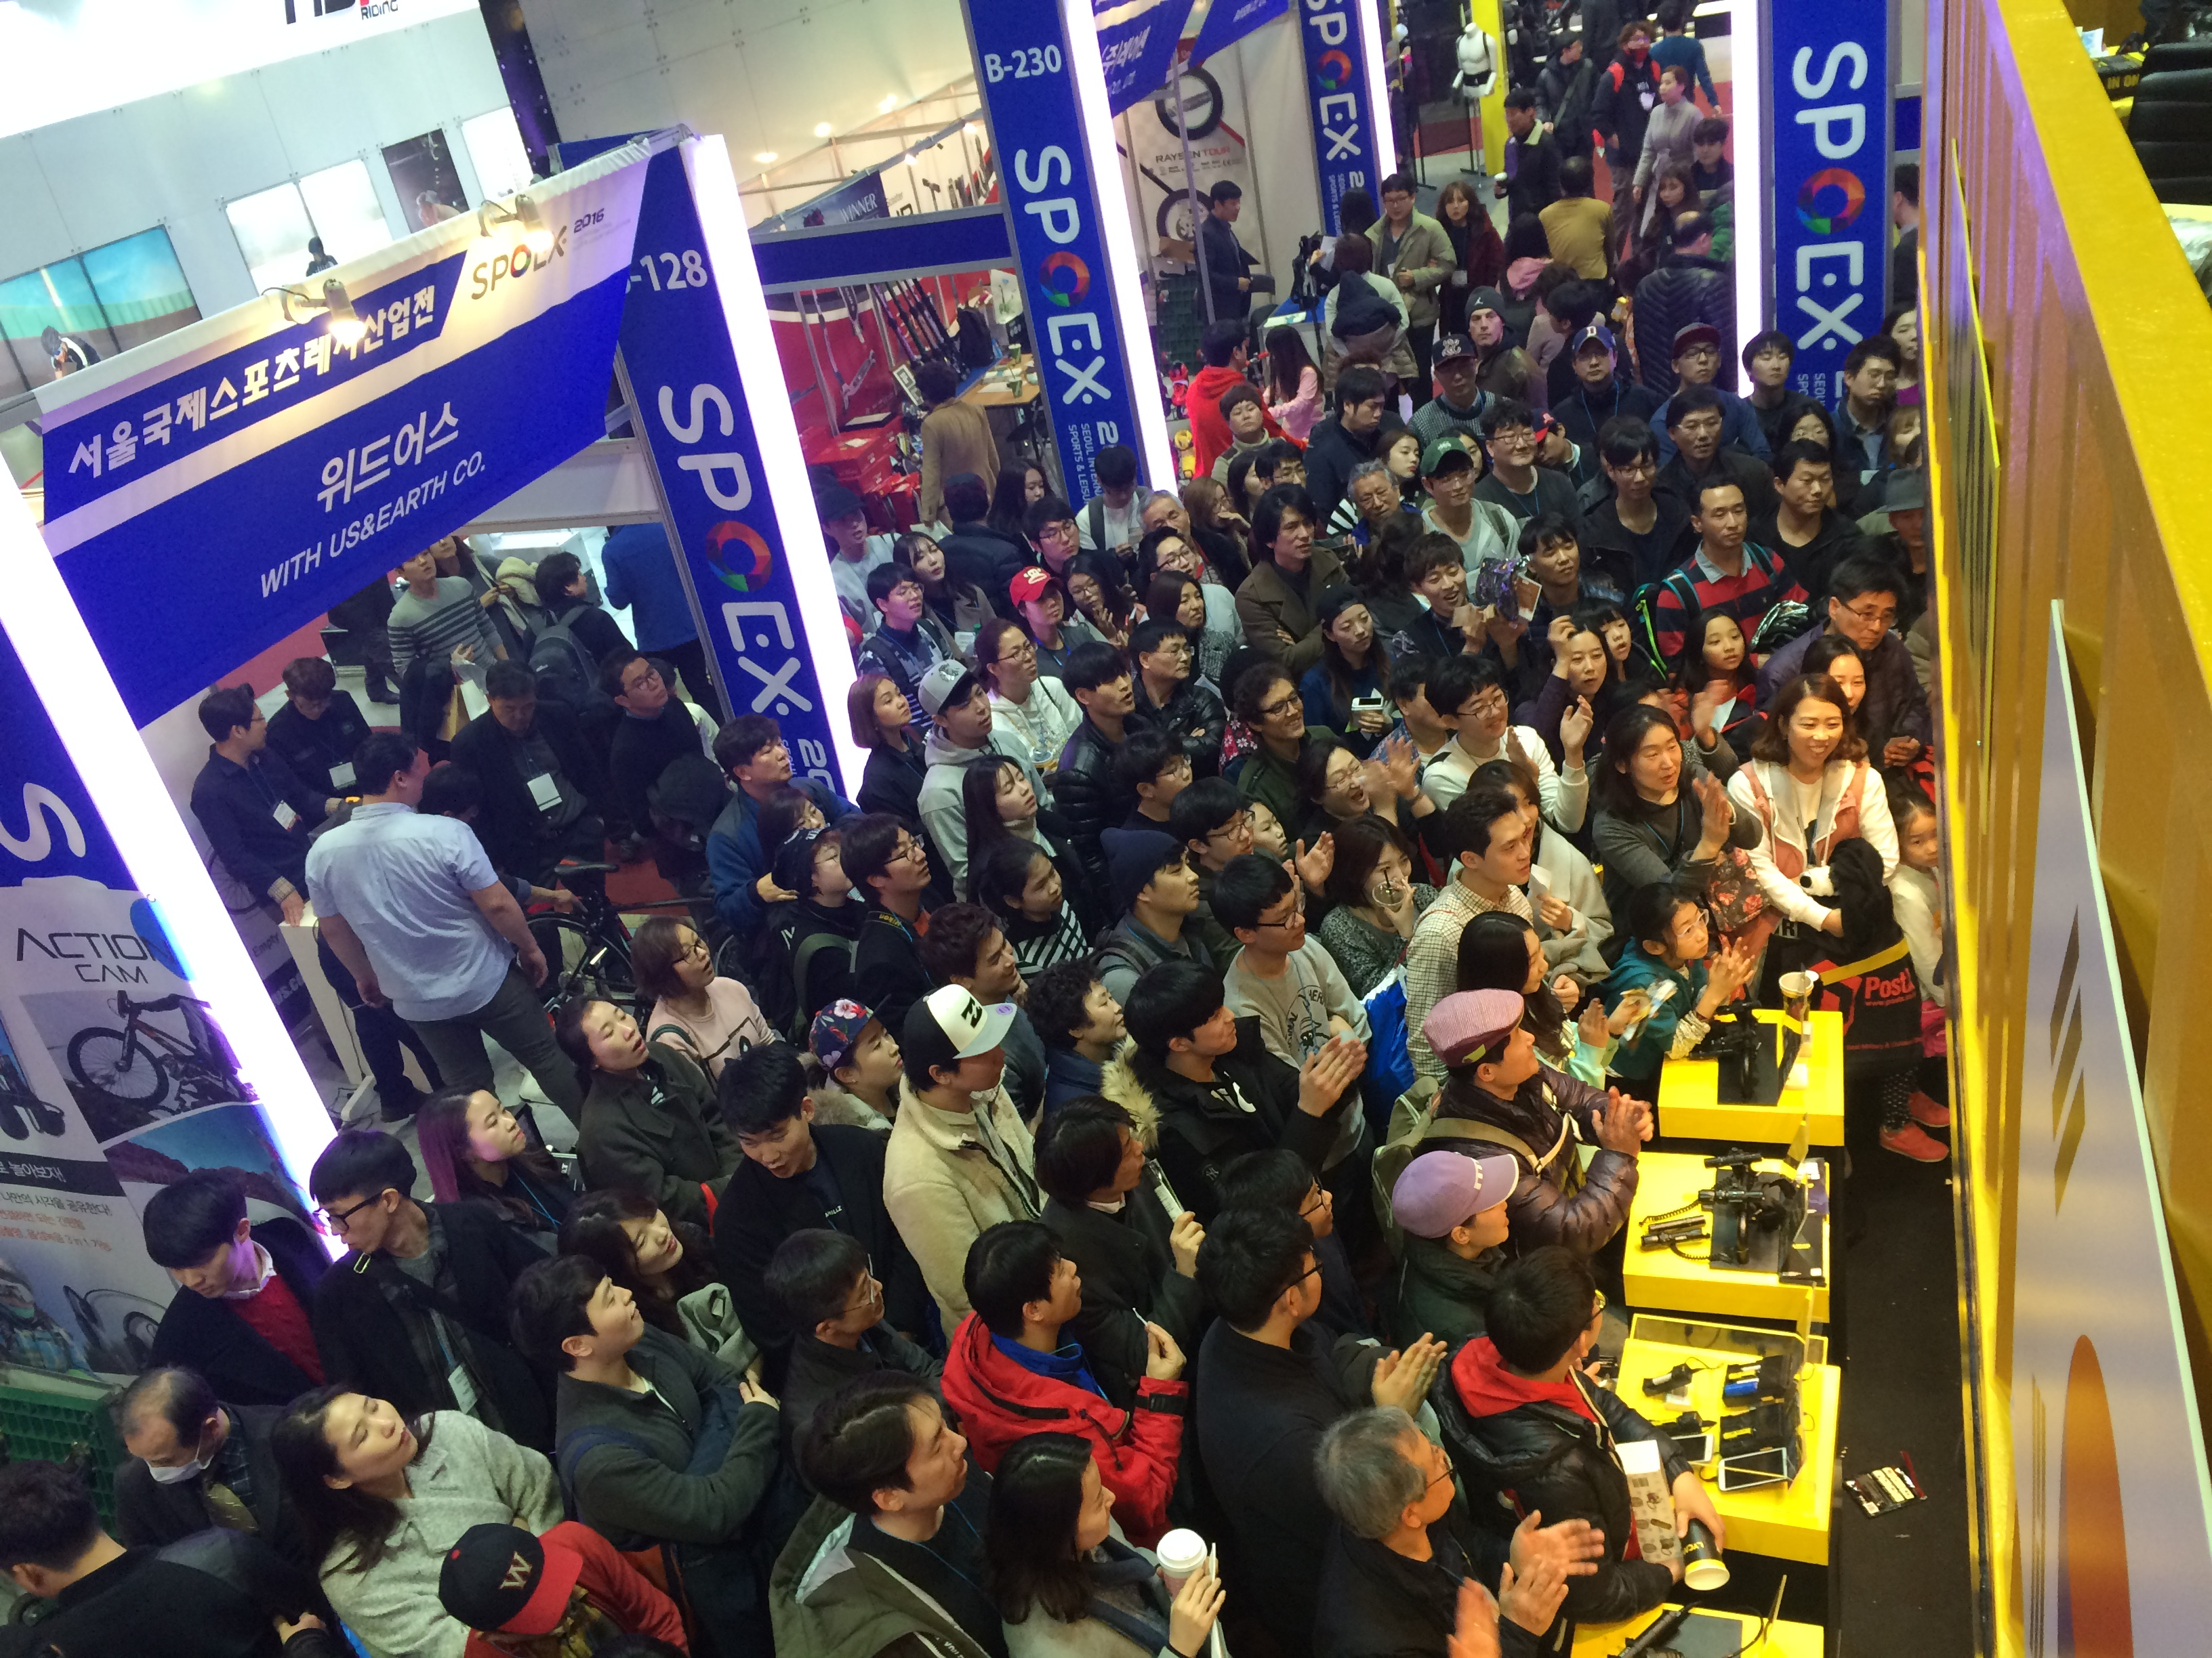

Slide 13
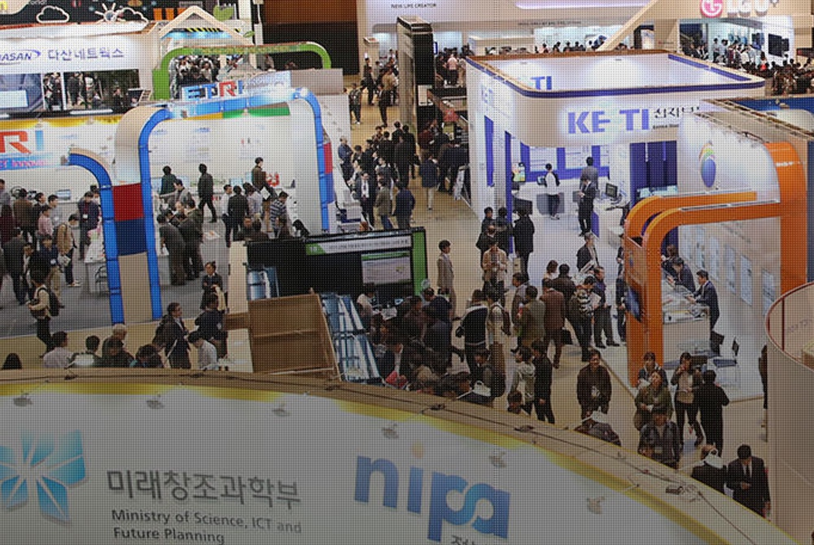

Slide 14
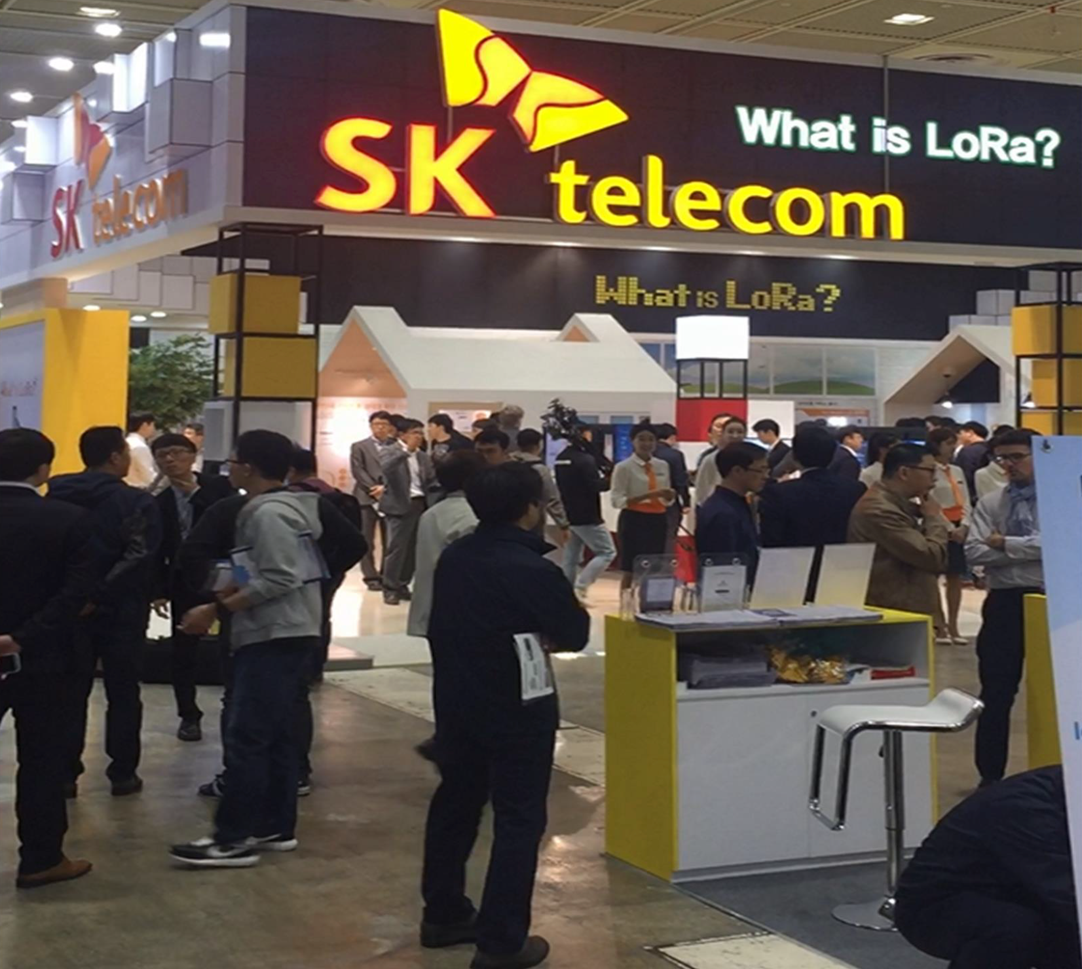
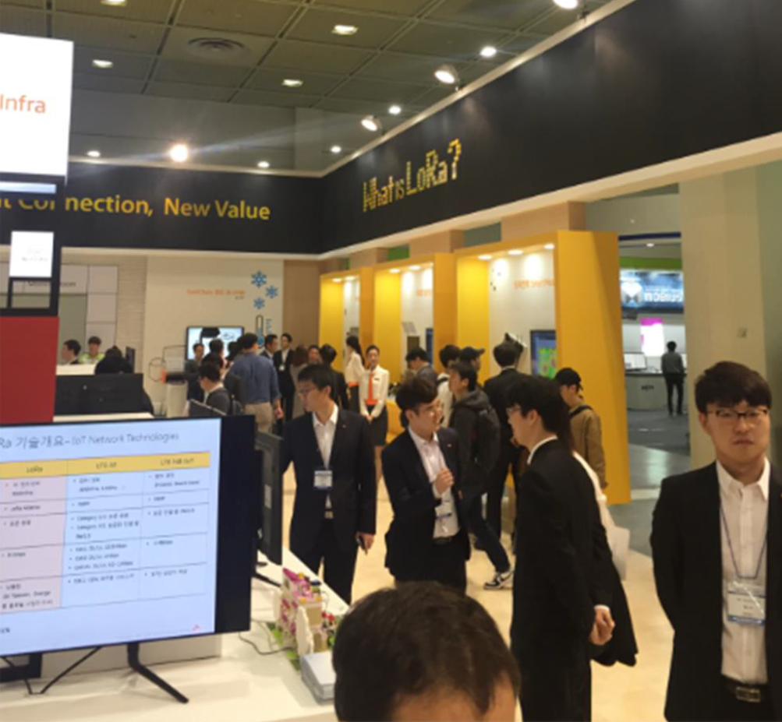
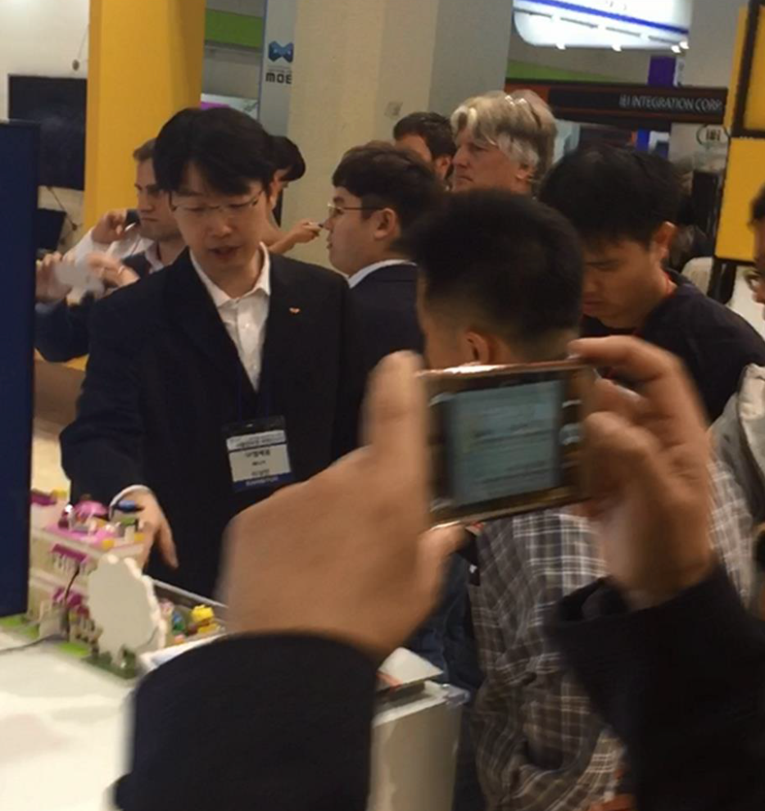

Slide 15
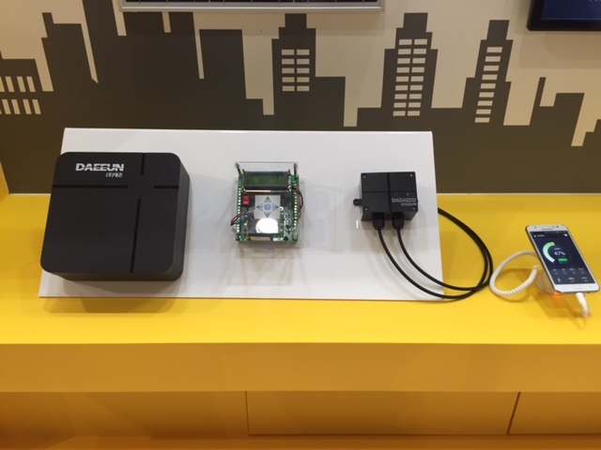
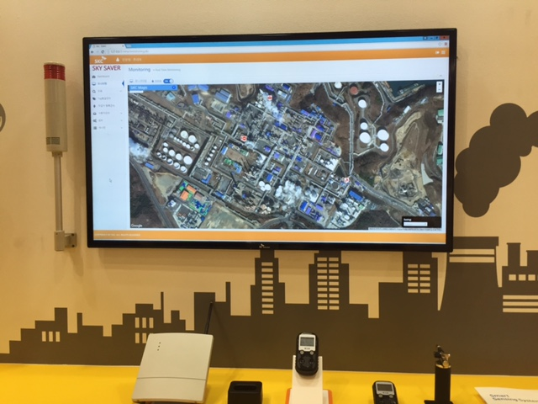
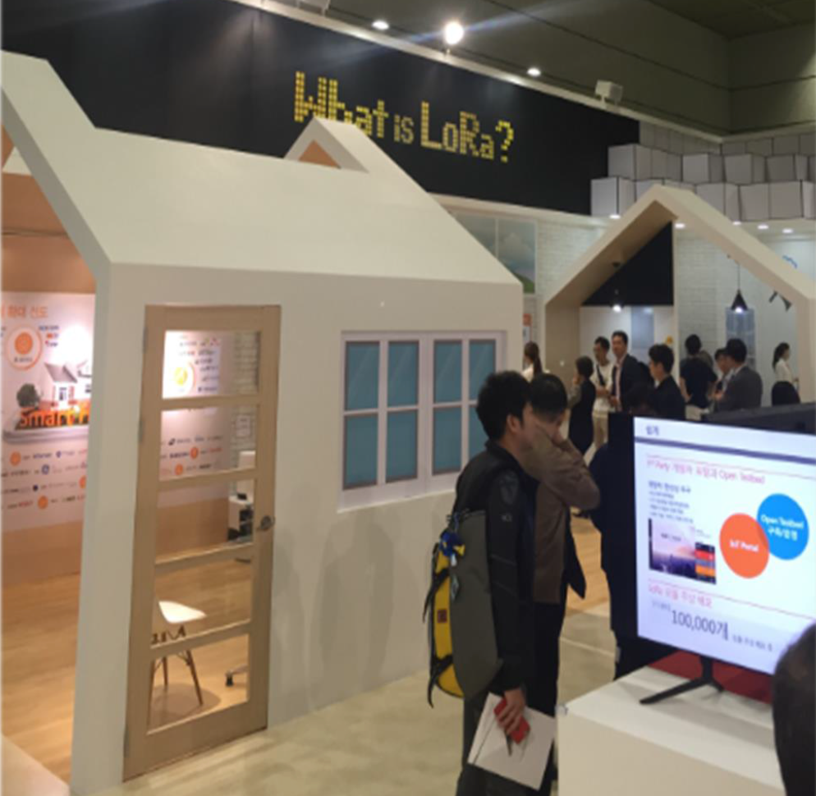

Slide 16
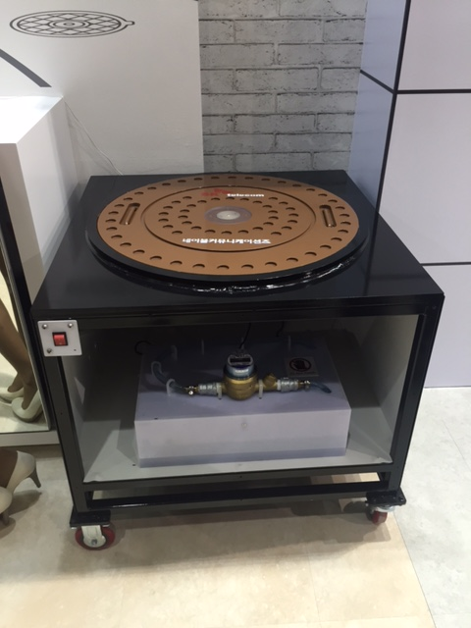
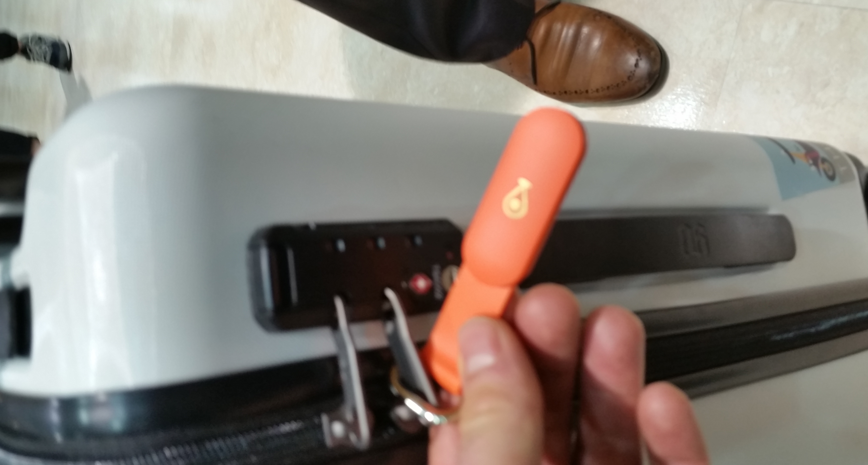

Slide 17
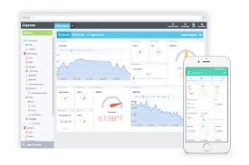
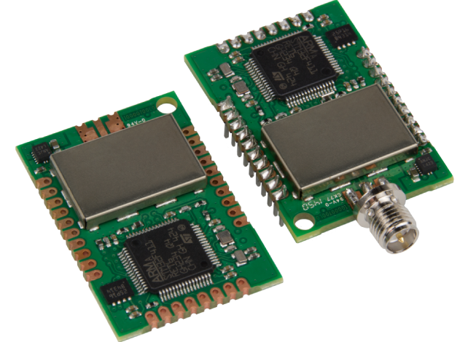
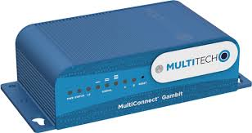

The Challenge
LoRaWAN Dev Kit
What will Comcast provide?
Network & Application Server
LoRaWAN Gateway
Training & Coaching

Slide 18
The Challenge Cont’d
Overview
5-7 faculty/student teams to create solutions on the machineQ™ platform
Feb 6
Training & 101
Feb 13
Office Hours Begin
Mar 27
Demo Day
Jan 1
On-going recruiting
Jan 30 Proposals due
Timeline
JAN
FEB
MAR
Prizes
1st Prize
$3k plus 6 month membership to Pennovation
Both teams win acceptance
into Penn’s I-Corps program
which provides business plan and customer discovery training
2nd Prize
$1.5k plus 6 month membership to Pennovation

